Slide 1

Yale University
Thurman Arnold Project
Student Papers
2024-2025
Remedies in Monopolization Cases
TAP@ Yale

Slide 2
Pharmacy Benefit Managers
(Administrative complaint before the FTC)
Aaron Combs
Sander McComiskey
Grace Sherrill
Cameron Steger
Elena Sokoloski
Imam Syed
TAP@ Yale

Slide 3
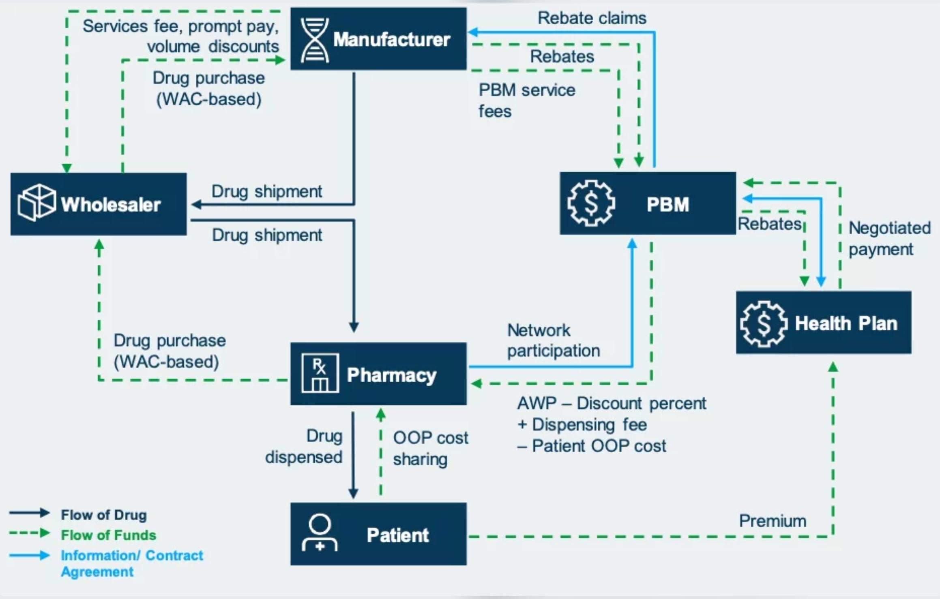
Complaint Overview
PBMs Distort Competition Through Market Power and Rebate Misalignment
Central Problem: PBMs leverage their dominant market position and opaque rebate structures to prioritize profit over patients—driving up drug prices, distorting competition, and misaligning incentives across the pharmaceutical supply chain.
PBM Power is Derived From its Three Functions
Formulary Design: Choose which drugs are covered at what patient cost.
Pharmacy Network Management: Decide which pharmacies get included in plan coverage.
Rebate Negotiation: Extract rebates from manufacturers in exchange for favorable placement.
Market Dynamics are Shaped by PBM Profit Motives:
Rebate-Driven Inflation: PBMs demand ever-larger manufacturer rebates, forcing list prices upward to maintain rebate margins.
Tier Manipulation: PBMs disadvantage therapeutically equivalent low-WAC drugs made by the same manufacturers to protect rebate flows from high-WAC counterparts.
Patient Cost Distortion: PBMs and insurers frequently link out-of-pocket costs to inflated list prices, shifting disproportionate costs onto patients—especially those with high-deductible plans or no insurance.
TAP@ Yale

Slide 4
Remedies Must Eliminate Core Incentive Failures—Not Just Punish Misconduct
Disrupt Business Models That Reward Price Inflation | Build Structural Guardrails That Outlast Litigation
Cut off the specific mechanisms PBMs use to profit from misaligned incentives: Mandate total pass-through of rebates and fees tied to WAC—removes PBMs’ incentive to prefer high-rebate drugs. Link patient cost-sharing to net price, not list price—ensures patients are not punished for rebate inflation. Prevent exclusion of therapeutically equivalent low-WAC drugs—protects against rebate-driven suppression of lower-cost options. | Go beyond case-by-case remedies to impose durable fiduciary constraints: Mandatory Fiduciary Duty Require PBMs to act in the best interest of health plans and patients—not their own profit margins. Prohibit self-serving practices like rebate retention or formulary decisions driven by manufacturer incentives. Create enforceable legal standards (duty of loyalty and care) that empower sponsors and beneficiaries to challenge misconduct directly.
Key insight: | Courts can address PBM misconduct, but only structural reforms that eliminate hidden incentives and enforce loyalty to patients will prevent it from recurring.
TAP@ Yale

Slide 5
FTC v. Amazon
John Kim
Cierra Robson
Grace Bu
(Presented By: Nick Jacobson)
TAP@ Yale

Slide 6
Complaint Overview
Alleged anticompetitive conduct falls into three broad categories:
Raise fees on Amazon while incentivizing merchants to raise prices at Amazon’s rivals → Prevents entry and raises prices
Condition sellers’ Prime eligibility on use Amazon’s fulfillment services → Raise sellers’ costs for fulfillment off Amazon and increase profits
As a retailer: algorithmically predict when competitors will follow Amazon price hikes to sustain price increases → Collusion
TAP@ Yale

Slide 7
Proposed Remedies
We propose three categories of remedies to address this conduct:
Prohibit Amazon from using merchant/sellers’ off-Amazon data in algorithms that control seller access to customers
Focus on algorithm inputs rather than overall data collection for easier monitoring, which may be a good model in other cases, too
Allow sellers to use other fulfilment services that can meet set standards (which Amazon has previously done without harm to consumers)
Require Amazon to delete the entirety of the Project Nessie algorithm and the related research and models of competitors
TAP@ Yale

Slide 8
United States v. Apple
Ashutosh Bakre
Ananya Agustin Malhotra
Sarena Martinez
Summia Tora
TAP@ Yale

Slide 9
Complaint Overview
Apple has monopoly power in the smartphone and performance smartphones markets. Apple has blocked the entry of competitors by:
Disrupting the growth of super apps.
Blocking the development of cloud-streaming services.
Making the quality of cross-platform messaging worse, less innovative, and less secure for users.
Limiting the functionality of third-party smartwatches.
Preventing third-party apps from offering tap-to-pay functionality.
TAP@ Yale

Slide 10
Proposed Remedies
To allow competition in Complementary Services (Apps and Devices), Apple must:
Grant access to all APIs that its own complementary services use.
Adopt publicly disclosed technical standards.
To allow competition in App Distribution, Apple must:
Allow rival vetted app marketplaces to be downloaded on iPhones.
Allow developers to offer alternative payment systems within their apps.
To allow competition in the Smartphone Market, Apple must:
Ensure messaging compatibility across platforms without degradation.
Allow users to transfer their “core handset data” across platforms.
TAP@ Yale

Slide 11
United States v. Visa
Iris Chen
Daniel Yim
Rena Liu
TAP@ Yale

Slide 12
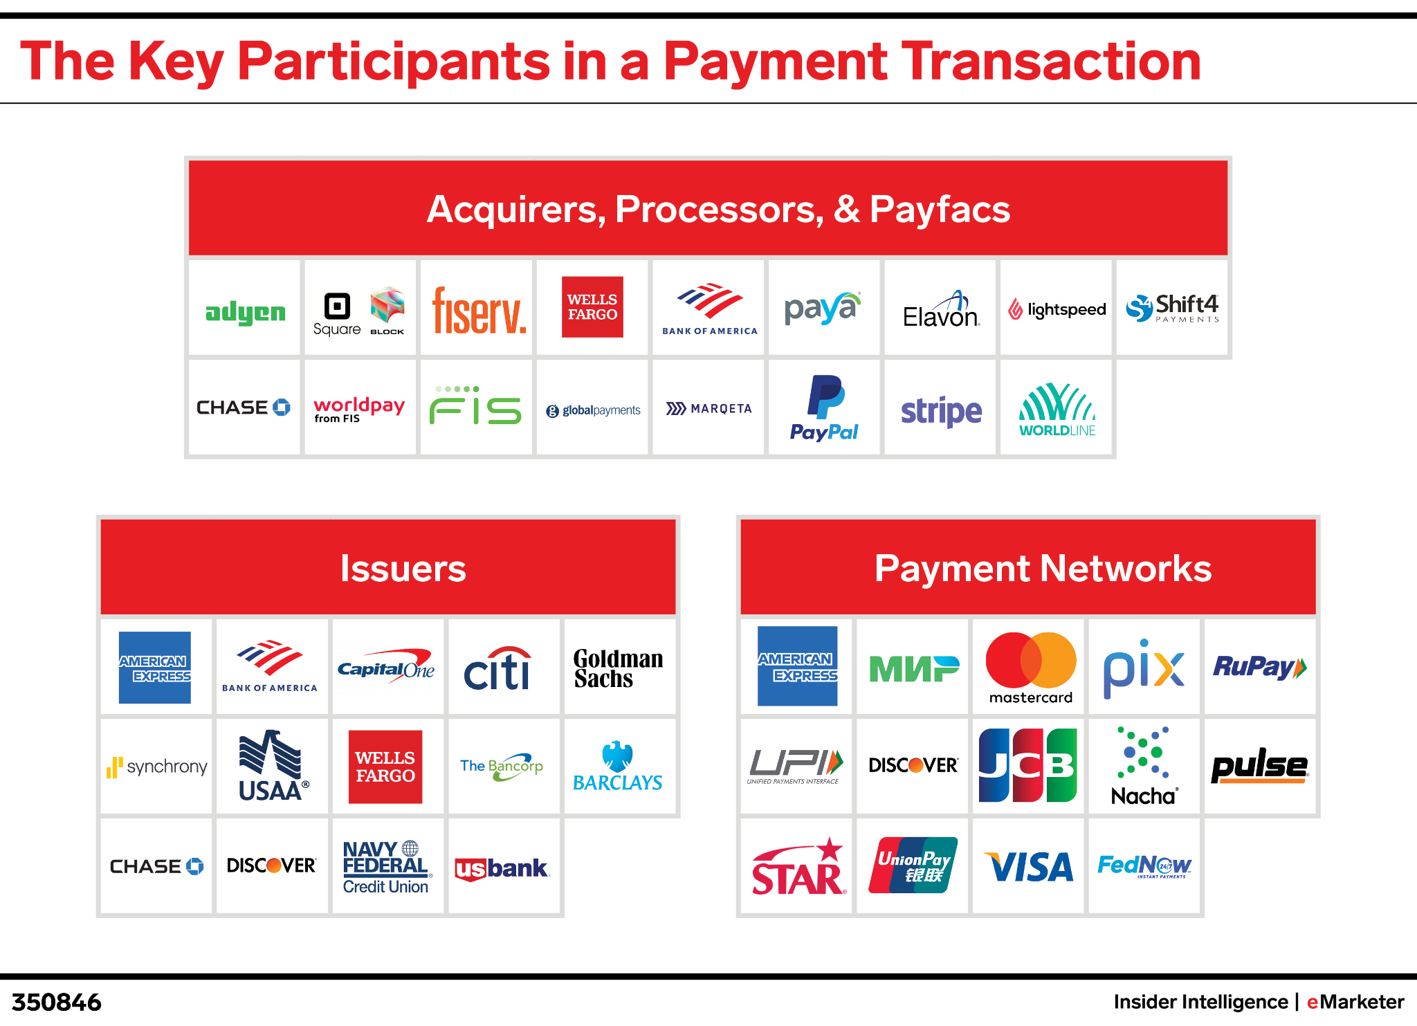

Complaint Overview
Visa excludes competitors
Visa blocks innovation
TAP@ Yale

Slide 13
Proposed Remedies
Protect banks’ choice to enable multiple routing networks on debit cards + make Visa pay for new cards Ban contracts incentivizing routing to Visa’s network in exchange for share or exclusives I.e. Cliff pricing, volume discounts, rack rates Ban contracts disincentivizing entry of payment alternatives (including PIN debit and fintech) I.e. Visa’s payments to fintech firms to not innovate
Linear debit pricing Interoperable security tokens
Divestiture to separate Visa's credit and debit businesses
TAP@ Yale

Slide 14
United States v. Live Nation & Ticketmaster
(Secondary Market)
Elizabeth Bailey
Mia Alvarez
Maggie Baughman
TAP@ Yale

Slide 15
Conduct
Complaint (Primary Market)
Live Nation “Flywheel”
Live Nation’s concert promotion business feeds its other high margin businesses, like ticketing, sponsorship, and advertising.
Raising Rivals Costs
Ticketmaster uses its “extensive network of long-term exclusive ticketing contracts to raise the costs of rival ticketers and further heighten barriers to entry”
Secondary Market
SafeTix technology requires that all transfers occur within the Ticketmaster platform.
Ticketmaster's market share in the primary market enables it to exclude rivals from the secondary market.
TAP@ Yale

Slide 16
Proposed Remedies
(1) Divestiture
Removes Live Nation’s leverage over venues and, consequently, over the secondary market.
Platforms will compete for contracts with venues based, in part, on secondary market services
There is some risk that divestiture will not restore competition for the secondary market, however. In light of that risk, we propose:
(2) Allowing rivals to interoperate through mandating that Ticketmaster offer royalty-free access to SafeTix API.
Removes Ticketmaster’s leverage over the secondary market.
Allows rivals to interoperate.
TAP@ Yale

Slide 17
FTC v. US Anesthesia Partners
Rachel Dai
Joshua Sprague Oliveira
Matthew Quintos
Marko Gajic
Victor Agbafe
TAP@ Yale

Slide 18
Complaint Overview
USAP achieved its “multi-year anticompetitive scheme to consolidate anesthesia practices in Texas” through:
Roll-up acquisitions of practices, consolidating markets in Dallas and Austin up to 60% market share.
Price-setting agreements with independent practices to raise their prices to the high rates set by USAP-owned practices.
Market allocation “to avoid a head-to-head rivalry with another large anesthesia provider”.
As USAP’s private equity sponsor, Welsh Carson has at all times “formulated, directed, controlled, or participated in the anticompetitive conduct.” Yet, WCAS’s motion to dismiss has been granted due to its minority stake, leaving the doctors of USAP holding the bag.
TAP@ Yale

Slide 19
Proposed Remedies
USAP:
Divest acquired anaesthesia practices
Enjoin USAP’s unlawful price-setting agreements
Require USAP to implement compliance programs.
WCAS:
WCAS must: (1) freeze its investment in USAP, (2) reduce Welsh Carson’s board representation in USAP to one seat, (3) obtain FTC approval for future investments in anesthesia; and (4) provide 30-day notice for acquisitions of other hospitals nationwide. [as outlined in the consent order]
Should be required to run ads in major medical journals informing doctors of legal liabilities associated with roll-ups.
FTC report studying the impact of PE rollups in healthcare and how to prevent them (Section 6(b)). Help Congress, the states, and private plaintiffs take steps to make these markets more competitive.
Other legislative and policy proposals at the state level including required reporting of all healthcare acquisitions / change of control.
TAP@ Yale

Slide 20
United States v. RealPage
Albert Wang
Victoria Diaz-Torres
Esteban Mendoza
Amina Elgamal
TAP@ Yale

Slide 21
Complaint Overview
Algorithmic Price Fixing: RealPage facilitated a conspiracy among property managers to use algorithmic tools to fix prices jointly while relying on shared, competitively sensitive data.
Monopolization: RealPage facilitated face to face meetings and required landlords to use procedures intended to promote adherence to its price recommendations.
RealPage sought to reduce price competition and raise prices in the rental market.
TAP@ Yale

Slide 22
Proposed Remedies
1. Regulating Algorithmic Design | 2. Limiting Access to Anticompetitive Data | 3. Eliminating “Dark Patterns” | 4. Creating a Technical Committee
Require RealPage to run individual pricing algorithms for each landlord, optimizing only that landlord’s profits rather than maximizing rents across the market. | For the general model, limit training data to publicly available data and impose “data contribution caps.” For individualized models, segregate data so that RealPage can’t integrate competitively sensitive data into the general model. | Prohibit default settings that coerce landlords into accepting price recommendations and remove price floors. | Establish a Technical Committee (TC) with experts in AI, law, and economics to oversee RealPage’s compliance.
TAP@ Yale

Slide 23
RealPage:
An Alternative Approach
Meher Sethi
Aarjav Joshi
Aparajita Kaphle
TAP@ Yale

Slide 24
Proposed Remedies
Why Other Remedies May Not Be Enough
Behavioral: Historically, behavioral changes lack compliance by firms Creation of technical committee is costly and poses monitoring issues | Structural: No practicable fault lines Divestiture would require a hard-to-devise and hard-to-enforce market cap
Our proposal: RealPage can recommend specific prices but only for one landlord per geographic market.
TAP@ Yale

Slide 25
Reimagining Algorithmic Antitrust Framework
Current antitrust norms fail to address algorithms’ potential to aid tacit collusion even though tacit collusion is a well-known ‘loophole’ in antitrust enforcement.
Under Bork’s Definition of Competition: Consumer welfare cannot be increased by judicial decree (how to make firms compete harder?); courts would do more harm than good
This error-cost calculus shifts when algorithms are involved: Algorithms introduce an “extra something”—an affirmative, targetable mechanism—that can be enjoined without imposing price controls or trying to direct the market.
Better Antitrust Framework: Courts are missing the ability to enforce against tacit collusion by remaining tethered to the human-based “agreement" standard. Focusing on the absence of people agreeing elevates formalism over outcomes, and moral culpability over economic effect.
TAP@ Yale

Slide 26

Thank you!
To read the papers, scan the code below.
TAP@ Yale

