Slide 1
Diving into the Digital Markets Act (DMA): Implementation and Implications
Gene Kimmelman
October 11, 2022

Slide 2
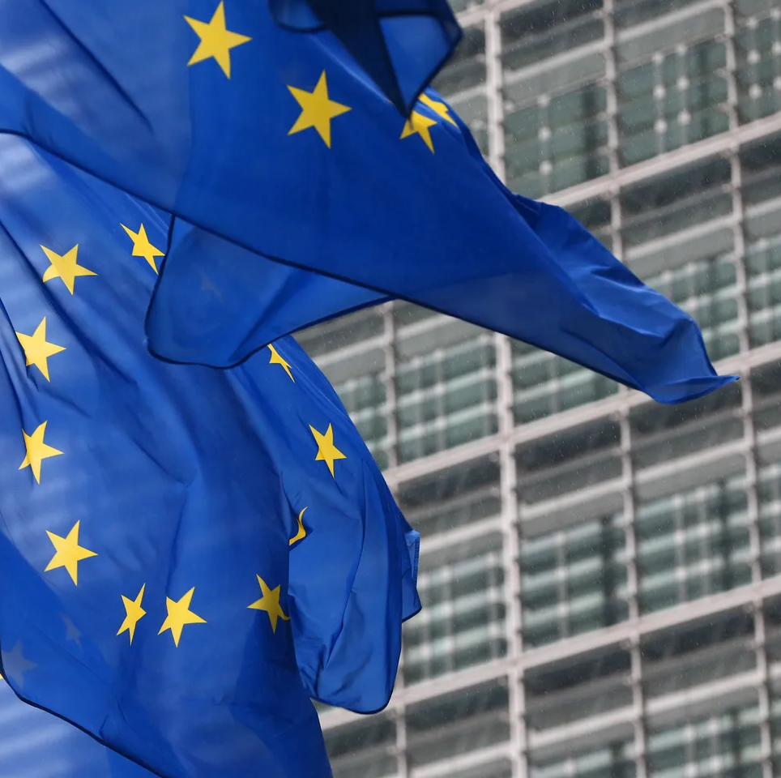
Europe is leading digital oversight in the 21st Century
United States leads in technology development.
Europe leads in regulatory development:
Creator economy v. consumer economy.
Reduced political power of dominant platforms.
Faster realization of limitations of antitrust solutions.
Notes:
Tom starts here

Slide 3
Why is Europe Leading?
Antitrust: “Tried it…now what?”
Political environment: “Us vs. them.”
Despite similar levels of inexperience among US and EU policymakers:
  In the United States, platforms frame the policy discussion in terms of the benefits their products and services deliver:
    Impact on innovation and investment.
    “Don’t break the magic.”
  In Europe, the focus has instead been on the effect of the technology:
    Focus on innovation places substantial weight on harms to potential and actual small competitors.
    Impact on investment and innovation doesn’t sell.
Economic importance leads to political power.

Slide 4
Introducing the DMA
Notes:
Gene starts here

Slide 5
Background on the DMA
The DMA is set to be published this month, with finalization of implementing regulations in December. Application of the DMA takes effect in Spring 2023, and it will be enforced at the EU-level through the European Commission.
DMA provisions are meant as a complementary tool to antitrust based on observed limitations of EU antitrust enforcement actions against dominant platforms.
The DMA is a rules-based approach to platform regulation, not principles-based. It thus specifies deadline-driven procedures, prohibitions on certain practices (e.g., contractual restrictions), and ex ante obligations (e.g., no self-preferencing), some of which may require technical implementations, to ensure contestability and fairness.
Companies subject to the DMA are identified as gatekeepers, including emerging ones, through an up-front designation mechanism using both quantitative and qualitative parameters.
Gatekeepers are providers of “core platform services” that: 1) have a significant impact on the European market; 2) provide a core platform service which is an important gateway for business users to reach end-users; and 3) enjoy an entrenched and durable position, in its operations, or it is foreseeable that they will.
Comprehensive remedies include fines of 10% of worldwide revenue in a preceding financial year (up to 20% in cases of repeated non-compliance), periodic penalty payments (up to 5% of daily revenue), and a merger moratorium for systemic non-compliance; DMA actions are not subject to efficiency defenses (though security and proportionality defenses can be made); enforcers are not required to engage with gatekeepers to implement DMA requirements.
Notes:
Quotes sourced from House Antitrust Subcommittee Report:
Mahoney - House Judiciary Antitrust Subcommittee Investigation of Competition in Digital Markets Report (October 6, 2020 , Pg 168
Spence – House Judiciary Antitrust Subcommittee Investigation of Competition in Digital Markets Report (October 6, 2020 , Pg. 50-51
Barnett – House Judiciary Antitrust Subcommittee Investigation of Competition in Digital Markets Report (October 6, 2020 , Pg. 51
Daru - https://www.vox.com/recode/22395840/apple-airtags-tile-tracker-antitrust-regulators

Slide 6
Dominant platforms and their discontents
“‘Twitter launched Vine today, which lets you shoot multiple short video segments to make one single, 6-second video,’ Osofsky wrote. ‘Unless anyone raises objections, we will shut down their friends API access today.’ ‘Yup, go for it,’ replied Zuckerberg.”- Exchange between Mark Zuckerberg and Facebook Executive (Justin Osofsky)
“These companies have gone so far as demanding that we suppress our inventions in order to work with them. The most recent example of this is Google's refusal to allow us to use multiple voice assistants on our product simultaneously. . . . I think the whole spirit of trying to encourage small companies, encourage new innovations and new startups is at risk, given how dominant these companies are.” - Patrick Spence, CEO of Sonos
“A former third-party seller and retired U.S. Marine told Subcommittee staff about several instances over his seventeen years as a seller when Amazon leveraged his work, undercut him on price, and eventually drove him out of business. In each instance, he had to change his business model after Amazon took over the Buy Box for his listings, ‘killing’ his sales. On at least two different occasions, his company did all the legwork to create a new, top-selling product or product line, as well as creating the product listings, only to have Amazon copy the idea and offer a competing product. Amazon used different tactics each time, but the result was always the same: Amazon profited from his work and made it impossible for him to fairly compete.” - Third-Party Seller on Amazon
“Apple launched this product, and its competing app, with a knowledge of a lot of information about our business. They know how our devices do in stores. They know who our customers are. They know our subscription take rates. They know what features people use. I mean, the list goes on and on.” - Kirsten Daru, former General Counsel of Tile
Notes:
Quotes sourced from House Antitrust Subcommittee Report:
Mahoney - House Judiciary Antitrust Subcommittee Investigation of Competition in Digital Markets Report (October 6, 2020 , Pg 168
Spence – House Judiciary Antitrust Subcommittee Investigation of Competition in Digital Markets Report (October 6, 2020 , Pg. 50-51
Barnett – House Judiciary Antitrust Subcommittee Investigation of Competition in Digital Markets Report (October 6, 2020 , Pg. 51
Daru - https://www.vox.com/recode/22395840/apple-airtags-tile-tracker-antitrust-regulators

Slide 7


How will the DMA impact Meta?
Interoperability requirements will enable seamless social network interaction.
Users will have data portability rights to move social network data to rival social networks.
Killer acquisitions will be limited through new requirements to inform the EC of mergers involving other platform providers, regardless of whether a merger would be subject to EC notification requirements or those under national competition authorities.
Unsubscribing from Facebook cannot be made difficult.
Advertisers must have access to performance measuring tools and information necessary for evaluating ad effectiveness.
Combining personal data from Facebook’s social networks with data from other services (Facebook Dating or Facebook Marketplace) will not be possible without user consent.
Notes:
Source: Moreno Belloso, N. (2022). The EU Digital Markets Act (DMA): A Summary. https://papers.ssrn.com/sol3/papers.cfm?abstract_id=4109299
Killer Acquisitions – Article 14
Data Portability – Article 6(9)

Slide 8


How will the DMA impact Google?
Rival search providers cannot be refused access to Google Search query data.
Core platform services cannot be bundled.
  For example, Google cannot condition licensing of its Play Store upon pre-installing the Google Search App and Chrome Browser, as it was found doing in the recently upheld Google Android decision (Sept. 14, 2022, GCEU).
Google Shopping cannot be treated more favorably compared to other comparison-shopping services in Google search result rankings.
Advertisers bidding for YouTube’s advertising inventory cannot be required to use Google Ads (Google’s advertising platform).
  Advertisers cannot be denied access to information about how much of their advertising spend on Google Ads is received by publishers.
Notes:
Source: Moreno Belloso, N. (2022). The EU Digital Markets Act (DMA): A Summary. https://papers.ssrn.com/sol3/papers.cfm?abstract_id=4109299
Ad Transparency – Articles 5(g) and 6(1)(g)
Search data sharing – Article 6(11)
Prohibitions on Tying Search and Chrome to Android – Derived from Google Android Case upheld Sept 14, 2022

Slide 9

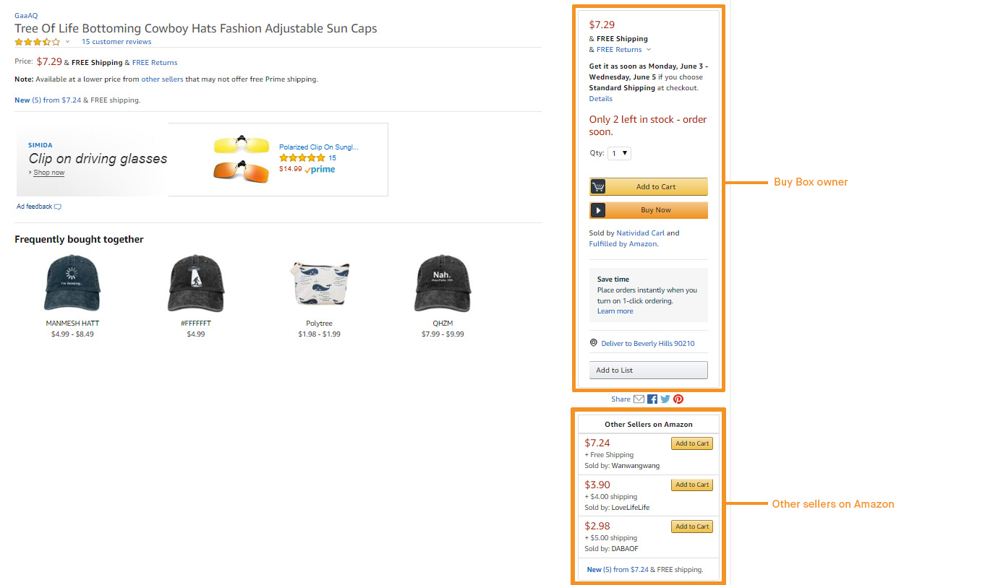
How will the DMA impact Amazon?
Businesses and publishers selling on Amazon’s marketplace cannot be restrained from selling on other platforms (e.g., Walmart, Target) at lower prices.
Data from third-party sellers cannot be used by Amazon to compete against those sellers as a first-party retailer.
Merchants complaining about Amazon business practices cannot be penalized (e.g., by contract).
Equal treatment will be given to all sellers when ranking offers to be selected for the Amazon Buy Box.
Notes:
Source: Moreno Belloso, N. (2022). The EU Digital Markets Act (DMA): A Summary. https://papers.ssrn.com/sol3/papers.cfm?abstract_id=4109299
Preventing use of third-party seller data – Article 6(2)
Self-Preferencing Prohibitions that would affect use of Buy Box – Article 6(d)

Slide 10


How will the DMA impact Apple?
Interoperability requirements are aimed at allowing users of competing messaging services to message iMessage users and ensuring Siri must work with non-Apple apps like Spotify.
App developers will have access to third-party payment platforms.
Access to Apple’s near-field communication (NFC) technology, used for tap-and-go payments, must be opened up.
Access to App Store cannot be conditioned upon requiring developers to include ‘Sign In with Apple’ option.
Subscriptions acquired outside an app (e.g., Spotify) cannot be prevented from applying to the iOS version of that app.
Uninstall options for pre-installed Apple apps must be offered.
iPhone users cannot be prevented from installing apps directly from developers outside the App Store (prohibiting ’sideloading’ restrictions).
Notes:
Source: Moreno Belloso, N. (2022). The EU Digital Markets Act (DMA): A Summary. https://papers.ssrn.com/sol3/papers.cfm?abstract_id=4109299
Messaging Interoperability – Article 7
Siri and Spotify Interoperability – Article 6(7)
Sideloading Limits – Article 6(4)

Slide 11
Summary of DMA Obligations and Prohibitions
Data-Related
Commercial Relations
Mobile Ecosystems
Reporting
Ban on data combination (5(2))
Data silos (6(2))
Data portability (6(9))
Access to data generated by users (6(10))
Access search data for online search engines (6(11))
Ban MFN clauses (5(3))
Anti-steering (5(4))
Reader rule (5(5))
Ban gag clauses (5(6))
Termination (6(13))
Un-installation/choice screens (6(3))
Side-loading apps (6(4)) Switching (6(6))
Report about implementation (11)
Inform about mergers (14)
Audit re techniques for profiling consumers (15)
Fair Access
Transparency
Interoperability
Tying
Fair ranking and ban of self-preferencing (6(5))
FRAND access conditions (6(12))
Transparency on ads pricing (5(9) and 5(10))
Transparency on ads performance (6(8))
Vertical interoperability for hardware/software (6(7))
Interoperability for NI-ICS (7)
Tying with ancillary services (5(7))
Tying between CPSs (5(8))

Slide 12
Antitrust and the DMA will overlap
DMA
Antitrust
Ex Ante
Ex Post
Slower, case-specific
Designates gatekeepers
General remedies
Case-specific remedies
Silent on cartels and abuse of economic dependence
Essential tool for merger control
Can reach novel/new forms of conduct that legislation did not anticipate
Mutually Supportive
51 antitrust cases by EU countries against potential DMA gatekeepers so far
Considerable overlap in targeted conduct (i.e., self-preferencing, unfair terms)
Notes:
- The Commission and national competition authorities should end current investigations that overlap with the DMA to avoid duplication of human resources and inconsistency between the DMA and antitrust laws.
- They can do by obtaining commitments from potential gatekeepers that they will comply with the DMA rules.
This is the path that Amazon and the Commission have adopted to close with commitments the Amazon Buy Box and Amazon Marketplace investigations (currently receiving feedback from market participants).
Such commitments will enable the competition authority to provide more guidance to potential gatekeepers on how they should comply with the DMA. The commitment will also save resources and time and avoid lengthy and costly legal antitrust challenges (and DMA legal challenges, if potential gatekeepers implement commitments effectively). Lastly, the commitments will force potential gatekeepers to comply with antitrust laws and the DMA in line with the Commission's expectations. In case of non-compliance with the commitments, the Commission could impose fines directly on potential gatekeepers under both antitrust laws and the DMA.

Slide 13
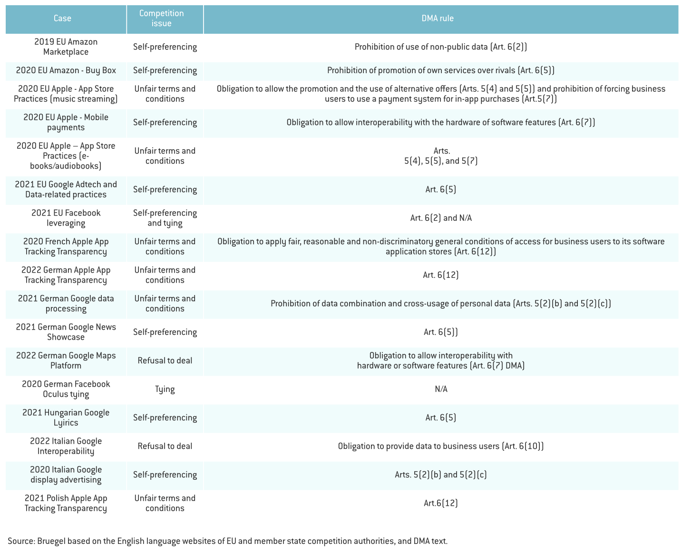
23 DMA-relevant antitrust cases also subject to DMA rules

Slide 14
Implementing the DMA

Slide 15
The DMA Applies to Gatekeepers
Companies that provide “Core Platform Services”
Include: online search engines (e.g., Google), social networks (e.g., Facebook), video-sharing platforms (e.g., YouTube), operating systems (e.g., Android), web browsers (e.g., Safari), virtual assistants (e.g., Alexa), cloud services (e.g., Microsoft Azure)…
have a significant impact on the internal market;
provide a core platform service which is an important gateway for business users to reach end-users; and
enjoy an entrenched and durable position, in its operations, or it is foreseeable that they will.
Gatekeepers

Slide 16
Presumed Gatekeepers
A company is presumed to be a gatekeeper if the company:
has EU turnover ≥ EUR 7,5B (in the last three financial years), or average market capitalization/fair market value amounting to ≥ EUR 75B (in the last financial year), provides the same core platform service in at least three Member States; and
provides a core platform service that has ≥ 45M monthly active end users in the EU or ≥ 10,000 yearly active business users in the EU – both thresholds met in each of the last three financial years.
Companies that meet these criteria can rebut the presumption. For that, they must demonstrate that due to exceptional circumstances they should not be designated as gatekeepers. The standard of rebuttal is very high.
The Commission can launch an investigation and designate a company as a gatekeeper based on a qualitative assessment, even if it does not meet the quantitative thresholds.
Significant impact on the internal market
Important gateway
+ entrenched and durable position
Notes:
Source: https://ec.europa.eu/commission/presscorner/detail/en/QANDA_20_2349

Slide 17
Who will apply the DMA?
Enforced by the European Commission – it will designate gatekeepers and impose fines, remedies, and penalties.
National competition authorities will have a supporting role – they can assess whether gatekeepers comply with DMA obligations; however, they cannot reach a conclusion of non-compliance.
Led by DG Connect – a directorate dealing with digital issues – and DG Comp – which enforces competition law.
How many staff will be on the Commission’s team?
At least 150 staff should be devoted to enforcing the DMA (MEP statement).
There will be a team with over 100 staff, combining both DSA and DMA (European Commissioner for Internal Market).
Dedicated teams will be organized around thematic areas for both the DMA and the DSA.
Societal issues team: DSA-related issues.
Technical team: e.g., interoperability of messenger services, the development of standards.
Economic team: e.g., DMA-related unfair trading practices, such as data access or so-called FRAND conditions.
Notes:
Sources: https://www.linkedin.com/pulse/sneak-peek-how-commission-enforce-dsa-dma-thierry-breton/?published=t, https://theplatformlaw.blog/2022/07/19/regulating-big-tech-raises-big-implementation-questions/, https://www.linklaters.com/en-us/insights/blogs/linkingcompetition/2022/june/the-dma-is-here-whats-next

Slide 18
Designation Process
Thresholds met | Thresholds not met
A company must notify the European Commission within 2 months. The company can present arguments that despite meeting the thresholds, it is not a gatekeeper. The Commission has 45 working days to designate the company as a gatekeeper and identify the relevant CPSs. If the company presents arguments but these do not manifestly put into question the presumption, the Commission can reject the arguments within the 45-day period. If the arguments manifestly put into question the presumption, the Commission can open a market investigation. The Commission has to communicate its preliminary findings within 3 months and conclude the investigation within 5 months. | The Commission has to conduct a market investigation considering some or all of the following elements: Size, operations, and position of the undertaking. Number of business and end users. Network effects and data-driven advantages. Scale and scope effects. Business or end-user lock-in (incl. switching costs and behavioral bias). A conglomerate corporate structure or vertical integration. Other structural business or services characteristics. The Commission has to communicate its preliminary findings within 6 months of opening an investigation. The Commission has to conclude its investigation within 12 months of opening an investigation.
Gatekeepers have to comply with the DMA obligations within 6 months of the designation. The EC can designate a gatekeeper based on it being foreseeable that it will enjoy an entrenched and durable position in the near future. The Commission can only then subject the gatekeeper to some of the DMA obligations. The EC has to review whether gatekeepers continue to be so at least every 3 years.
  .
Notes:
Source: Moreno Belloso, N. (2022). The EU Digital Markets Act (DMA): A Summary. https://papers.ssrn.com/sol3/papers.cfm?abstract_id=4109299

Slide 19
Reporting Obligations
Gatekeepers must provide the Commission with a report describing in a detailed and transparent manner the measures they have implemented to ensure compliance with the obligations laid in the DMA (within 6 months of its designation as gatekeepers).
  Gatekeepers must update those reports at least annually.
  The Commission will make a non-confidential summary of the reports available on its website.
Gatekeepers must inform the Commission of any merger involving CPSs or other digital services or that enable them to collect data; regardless of the EU Merger Regulation.
Gatekeepers must submit an independently audited description of any techniques for profiling of consumers.

Slide 20
Sanctions and Remedies
Infringing the DMA can result in significant fines:
Up to 10% of its total worldwide turnover for the first offense.
Up to 20% of its worldwide turnover for a repeat offense.
In case of systematic infringements, the Commission can impose behavioral and structural remedies. These remedies can include obliging a gatekeeper to sell a business, or parts of it (i.e., selling units, assets, intellectual property rights, or brands), or banning a gatekeeper from acquiring any company that provides services in the digital sector or services enabling the collection of data affected by the systematic non-compliance.
Systematic infringement if the company violates the rules at least three times in eight years.
The Commission can also impose periodic penalty payments of up to 5% of the company's total worldwide daily turnover.
Notes:
Sources: https://ec.europa.eu/commission/presscorner/detail/en/QANDA_20_2349, https://www.consilium.europa.eu/en/press/press-releases/2022/07/18/dma-council-gives-final-approval-to-new-rules-for-fair-competition-online/

Slide 21
Appeals and Interim Measures
Appeals to the European Commission’s Decision:
The Court of Justice has unlimited jurisdiction to review decisions by which the Commission has imposed fines or periodic penalty payments. It can cancel, reduce or increase the fine or periodic penalty payment imposed.
Interim measures (measures adopted while the investigation is ongoing):
In case of urgency due to the risk of serious and irreparable damage for business users or end users of gatekeepers, the Commission can adopt interim measures against a gatekeeper on the basis that, at first sight, it is infringing the DMA obligations. Interim measures must only apply for a specified period of time and can be renewed in so far this is necessary and appropriate.
Notes:
Sources: https://ec.europa.eu/commission/presscorner/detail/en/QANDA_20_2349, https://www.consilium.europa.eu/en/press/press-releases/2022/07/18/dma-council-gives-final-approval-to-new-rules-for-fair-competition-online/

Slide 22
Exemptions and Defenses
The DMA does not allow for an efficiency defense – companies cannot argue that their conduct (prohibited by the DMA) is pro-competitive and has a net positive effect on consumers. The legislator has already considered the trade-off and established that they must always be prohibited.
The Commission can:
Exempt gatekeepers from their DMA obligations on the grounds of public health or public security.
Suspend a DMA obligation for a core platform service of a gatekeeper. The gatekeeper has to demonstrate that compliance would endanger the economic viability of its EU operations due to exceptional circumstances beyond its control.
According to a general EU law requirement, provisions must be proportionate to their objectives.
Implications of the lack of efficiency defense — Examples:
- Google cannot favor its own flight comparison service even if it believes it is the most effective one in the market.
- Amazon cannot use sellers’ data even if this would allow Amazon to better serve its customers (e.g., promoting products they demand).
Notes:
Sources:https://www.youtube.com/watch?v=8M8bmdhELc0), Moreno Belloso, N. (2022), Fletcher, A. (2022)

Slide 23
Anti-circumvention provision
Companies providing core platform services must not segment, divide, subdivide, fragment or split those services through contractual, commercial, technical or any other means in order to circumvent the quantitative thresholds to be designated a Gatekeeper.
The Commission can, when it suspects that a company providing core platform services is engaged in this practice, require from that undertaking any information that it deems necessary.
In addition, Gatekeepers must not engage in any behavior (e.g., contracts, interface design) that undermines effective compliance with the DMA substantive obligations.
Gatekeepers must not degrade the conditions or quality of any of the core platform services provided to business users or end users who avail themselves of the rights or choices laid down in the DMA or make the exercise of those rights or choices unduly difficult, including by offering choices to the end-user in a non-neutral manner, or by subverting end users’ or business users' autonomy, decision-making, or free choice via the structure, design, function or manner of operation of a user interface.

Slide 24
Implementation Challenges
Challenges posed by the DMA:
Companies may contest the fact that they are gatekeepers, especially where they do not meet the thresholds.
Some of the DMA obligations leave room for interpretation.
  Example: regarding the interoperability of messaging communications services, the DMA specifies that companies must not be prevented from taking measures to ensure integrity, security, and privacy. This may involve difficult considerations, given end-to-end encryption.
Some obligations are limited to very specific actions.
  Example: self-preferencing is only prohibited for ranking and indexing, so some self-preferencing can persist.
The EU law proportionality requirement might provide a route for legal challenges by gatekeepers.
The European Commission has pointed out that:
The DMA is uncharted territory for the Commission, the gatekeepers, and third parties.
The DMA implementation will require “testing.” This will imply a lot of discussions with the gatekeepers – so they can explain their business models – and third parties – so they can explain the market realities. There will be an open-door policy.
There is information asymmetry: the Commission knows less about the market than gatekeepers.
The Commission aims to a collaborative approach as a starting point – find solutions that comply with the law and make sense from a business perspective. If that does not work, the Commission will move on to enforcement.
The Commission will ramp up expertise with internal know-how and external experts.
Notes:
Sources: https://www.youtube.com/watch?v=8M8bmdhELc0, https://www.linklaters.com/en-us/insights/blogs/linkingcompetition/2022/june/the-dma-is-here-whats-next, Fletcher, A. (2022)

Slide 25
US Proposal in the spirit of the DMA
The American Innovation and Choice Online Act (S.2992), often referred to as the “Klobuchar Bill”, focuses on harmful self-preferencing and discrimination by gatekeeper platforms that control key chokepoints of digital markets, akin to the DMA.
Applies to major business lines of platforms that:
  Act as critical trading partners.
  Have more than 50M monthly active US users or 1B worldwide users.
  Have more than 100,000 active US business users.
  Record net annual sales or a market capitalization of more than $550B.
  Other qualifying criteria.
Includes but is not limited to products or business lines from Amazon, Apple, Google, Facebook, Microsoft, TikTok, and others.
Example of targeted conduct: Amazon could not show Amazon Basics batteries before those made by Duracell.
Unlike with the DMA’s lack of efficiency defenses, defendants retain affirmative defenses such as establishing that relevant conduct “has not resulted in and would not result in material harm to competition”.
Where does it stand?
Approved by the Senate Judiciary Committee with bipartisan support.
Senator Schumer stated he does not believe it has 60 votes to overcome a filibuster.
Notes:
new law effective 2021
Amazon announcement in 2021
This is Qualitative
Quantitative consideration
EU and US – some of the factors considered:
Turnover
Average market capitalization
Fair market value
End and business users

Slide 26
UK Proposal
The UK Government is at an advanced stage in preparing legislation and the proposed regulator – the Digital Markets Unit – is already operative in shadow form (within the CMA).
The UK proposals to designate companies are entirely qualitative. The assessment of whether firms have ‘Strategic Market Status’ would be based on whether a firm has substantial, entrenched market power in at least one digital activity.
The legislation would include only fairly high-level objectives, with rules to be developed by the Digital Markets Unit for each platform during the designation process. The UK proposal allows for these rules to be bespoke, reflecting each platform’s particular market position and business model.
The proposed UK framework has been designed to be relatively open to arguments for exception. The draft language of the specific principles incorporates a number of caveats, while an exemption can more generally be given where this is necessary or objectively justified in terms of efficiencies, innovation or other competition benefits.
Notes:
Source: Fletcher, A. (2022)

Slide 27
Will the DMA have a global impact?
The DMA rules, in theory, only apply to services offered to businesses and consumers in the European Economic Area (EEA).
This means that, in theory, gatekeepers can behave in a way that complies with the DMA in the EEA and differently in other regions.
However, some gatekeepers may prefer to align their business models with the DMA globally to avoid extra costs – if so, the DMA could have the “Brussels Effect,” according to which EU regulation, in practice, sets global standards. However:
The costs of having various business models are likely different between gatekeepers. Some companies might have more incentives to have a uniform business model worldwide than others.
GDPR may have established worldwide standards, but Google has just implemented the remedy for the EU Google (Android) case in the EEA.
Some relevant (unanswered) questions – will similar regulations be approved in other countries? Will they be influenced by the DMA? Will companies adjust to the strictest standard? Will there be incompatibilities?
Notes:
Source: https://www.linklaters.com/en-us/insights/blogs/linkingcompetition/2022/june/the-dma-is-here-whats-next

Slide 28
