Slide 1

USING RUBRICS TO IMPROVE GRADING CONSISTENCY

Slide 2

WHAT ARE RUBRICS???

Slide 3

AND WHY ARE THEY AWESOME?

Slide 4
THE AWESOMENESS OF RUBRICS
OBJECTIVITY
CONSISTENCY
EFFICIENCY
ALSO…
A STRUCTURE FOR FEEDBACK
TOOL TO COORDINATE ACROSS GRADERS

Slide 5
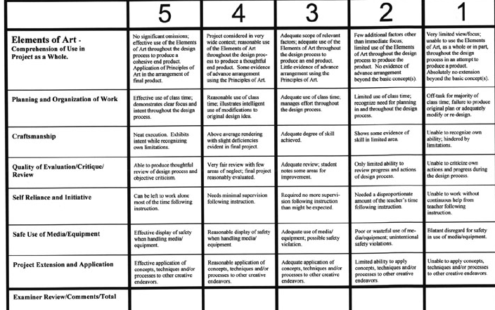
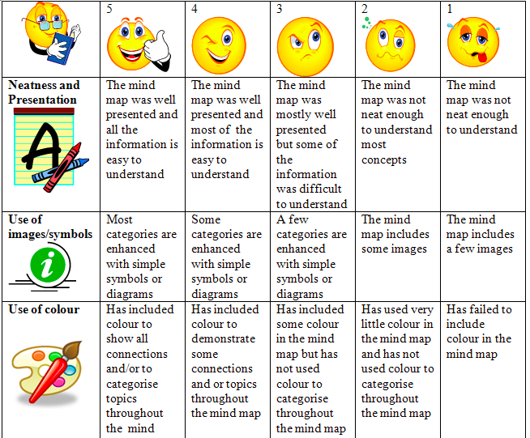
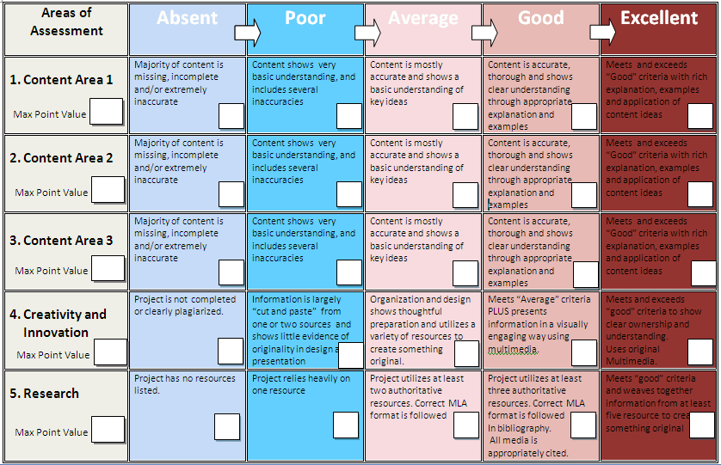
EXAMPLES OF RUBRICS
http://bit.ly/1KISe4L

Slide 6
RUBIC USAGE (1/2) EXPECTATIOMMENDATIONS
Grading rubrics should be used for ALL assignments, and particularly written assignments (qualitative assignments, papers, projects, etc)
If professor does NOT have a rubric for an assignment:
TAs should develop a rubric for professor approval
If professor DOES have a rubric for an assignment:
TAs should review and ensure it is objective
Grading of written assignments should be anchored in “Exemplars” aka top student work from the course last year. Great for consistency and framing feedback to students.

Slide 7
RUBIC USAGE (2/2) EXPECTATIOMMENDATIONS
Best practice for grading consistency: NORMING
How does it work?
Before diving into grading a full assignment, all graders should grade multiple papers together
The group norms or calibrates their collective interpretation of the rubric and the assignment
The graders can then divide assignments and grade independently, but in a consistent manner
NOTE: Norming can be done virtually if necessary

Slide 8
THANK YOU!
A few new ideas SG is considering…
TA Workshops:
How to: build a bomber rubric
How to: run a rocking ta review session
TA community-building events
Networking with senior faculty

