Slide 1


Will Europe’s New Tech Platform Regulations Open the Door to Competition?
Gene Kimmelman
Hila Aka

Slide 2
What is the Digital Markets Act (DMA)?
“Core platform service”:
online intermediation services
online search engines
online social networking services
video-sharing platform services
interpersonal communications services
operating systems
web browsers
virtual assistants
cloud computing services
online advertising services
Digital Markets Act
Promote promote contestability and fairness
Six designated online gatekeepers
Compliance by March 6, 2024
DMA is a complementary tool to antitrust

Slide 3
DMA Obligations – Overview
Behavioral Obligations
Focused on Core European Commission (EC) objectives:
  Reduce advantages of big data and lower entry barriers
  Facilitate switching and multihoming
  Platform or device neutrality
  Prevent lock-in effects
  Promote contestability and fairness to business users
  Prohibit “leveraging” such as tying
                (ex: Google requires Android manufacturers that preinstall the Play store also preinstall Google Search and Chrome), sideloading (not allowing third-party application stores or software to run on an operating system), or limits on gatekeeper ID or payment services

Slide 4
DMA Obligations – Overview
Defines mandatory interfaces based on platform chokepoints, designed to promote competition on digital platforms
Lowers entry barriers
Reduces platform advantages that limit opportunities to compete
Requires fair treatment of business users

Slide 5
How the Gatekeepers are Complying

Slide 6
User consent for combining personal data
Gatekeepers are required to obtain user consent for using third-party data, combining data between platforms, and automatically signing in users to combined their data third-party
Google
Users can revise at any time
No consent -> less personalized but equivalent alternative
Signed-out users are non-consented by default
Meta
No consent -> subscription
Consent -> personalized ads
Users choose across services:
      Facebook, Instagram, Facebook Messenger, Facebook Marketplace, Facebook Gaming Play and Facebook Dating.
Microsoft
No auto log into different services
Consent for combining Windows + Microsoft products data
Same changes to LinkedIn

Slide 7
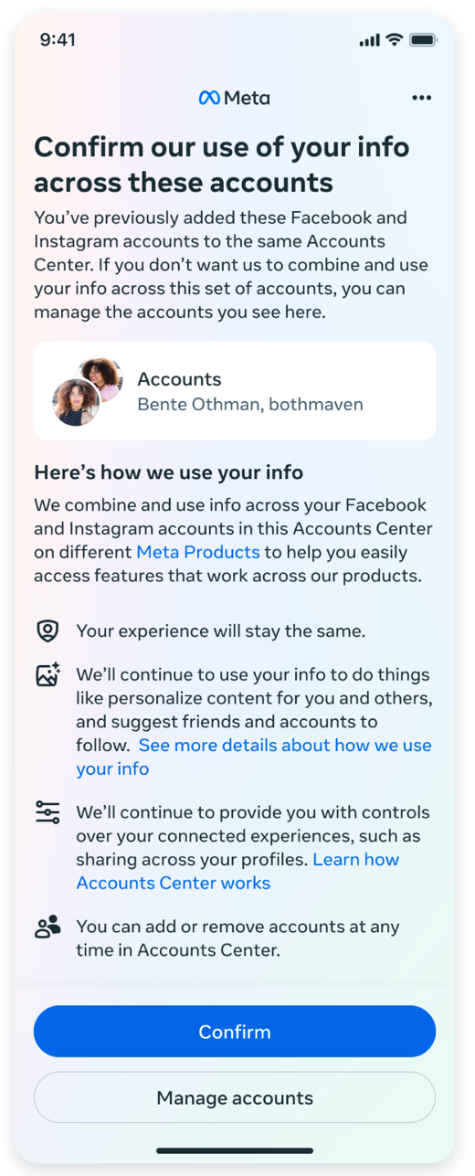
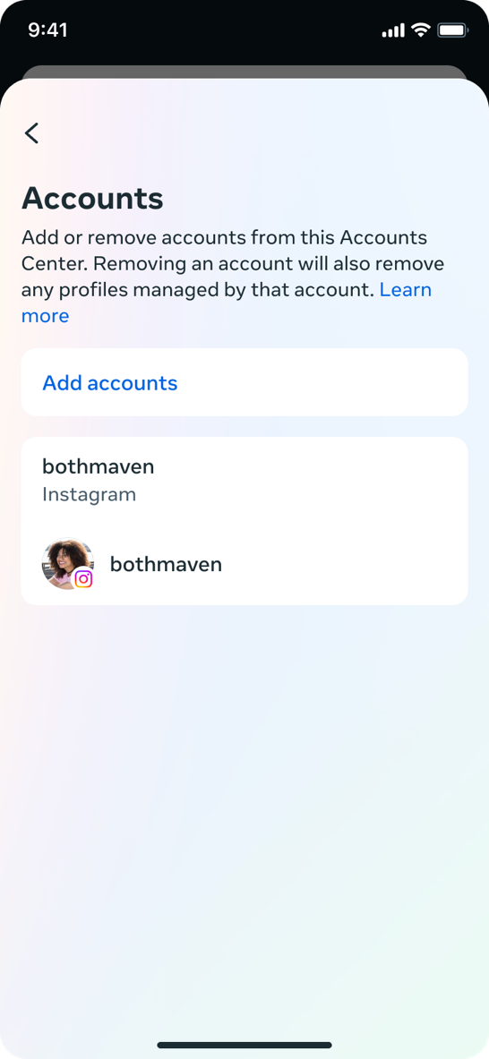
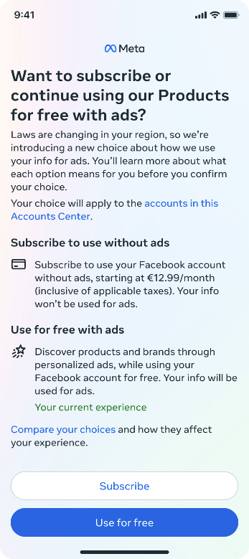

Slide 8
User consent for combining personal data third-party, cross-service, auto log-in
European Commission has started investigating Meta for noncompliance
“… binary choice imposed by Meta's “pay or consent” model may not provide a real alternative in case users do not consent, thereby not achieving the objective of preventing the accumulation of personal data by gatekeepers.”

Slide 9
Subscription, Registration to Access a Core Service
Gatekeepers cannot condition business or end users’ access to one core service on the users subscribing or registering with another core service
Meta
Users can access a logged-out version of Facebook Marketplace
Standalone and independent version of the Facebook Marketplace

Slide 10
Uninstallation Easily Switchable Defaults, Choice Screens third-party, cross-service, auto log-in
Google
Change default browser and search engine in the setup and in settings
OS and Chrome
Developers can apply to be shown on the choice screen
Fully randomized choice screen.
Uninstall all pre-installed apps
Apple
Third-party contactless payment app — or an alternative app marketplace — as default
Choice screen when users first open Safari will prompt EU users to choose a default browser from a list
Requirements: at least 5,000 annual users across all the EU; available on the App Store
Microsoft
Enabled third-party web search applications to offer web search services through the search box on the Windows taskbar
Uninstall all pre-installed apps, including the Edge browser and the Bing web search

Slide 11
Uninstallation Easily Switchable Defaults, Choice Screens
Google Choice Screen
New browser choice screen during initial device setup in addition to a search choice screen on Android smartphones and tablets
Search choice screen on Chrome on non-Android platforms
All choice screens are free to participate in
If a non-Chrome browser or non-Google search engine is already selected, Android will not show a browser/search choice screen.
The twelve most popular eligible browsers/general search services in each country according to Google Play installation data
All twelve options will be ordered randomly each time
  For an initial period, the five most popular at the top and the next seven most popular browsers at the bottom.

Slide 12
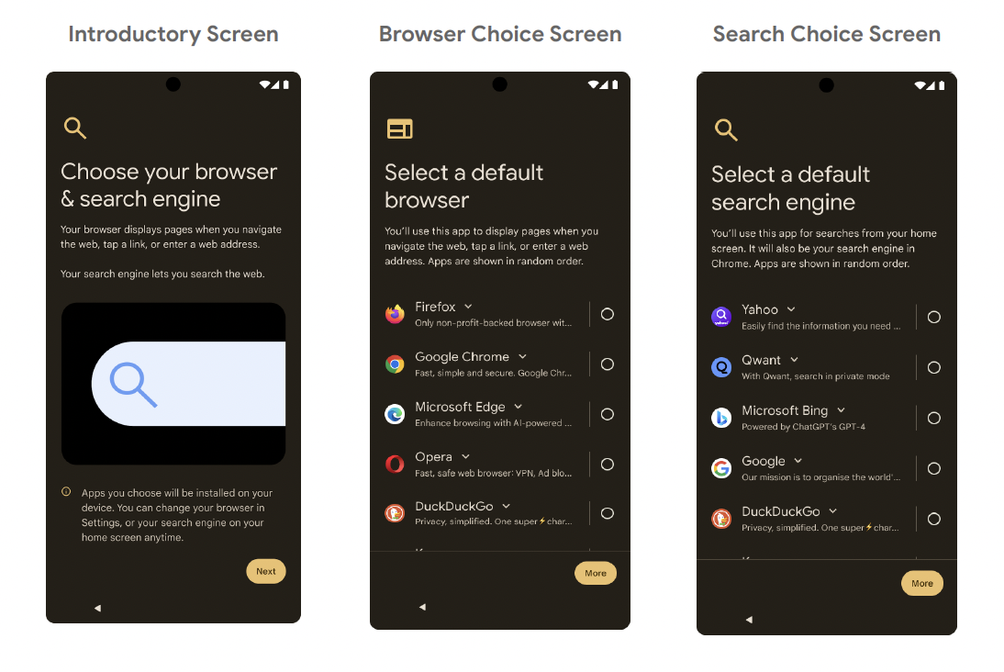
Uninstallation Easily Switchable Defaults, Choice Screens
Google

Slide 13
Uninstallation Easily Switchable Defaults, Choice Screens
Apple Choice Screen
Users prompted to choose their default browser and presented with a list of the main web browsers
The first time a user in the EU opens Safari on their iPhone
Up to 11 of the most downloaded browsers on iOS in that country in the prior year, in addition to Safari
List updated once per calendar year.
Announced new default control for users in Settings for navigation apps

Slide 14
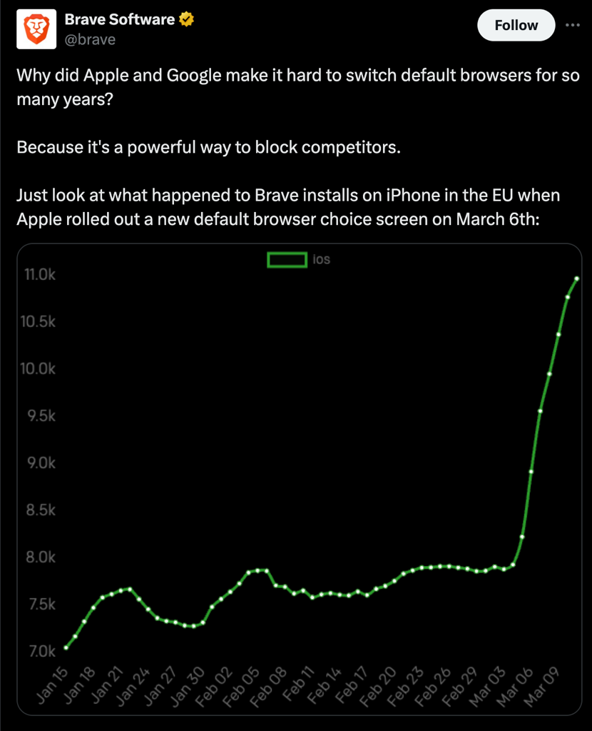
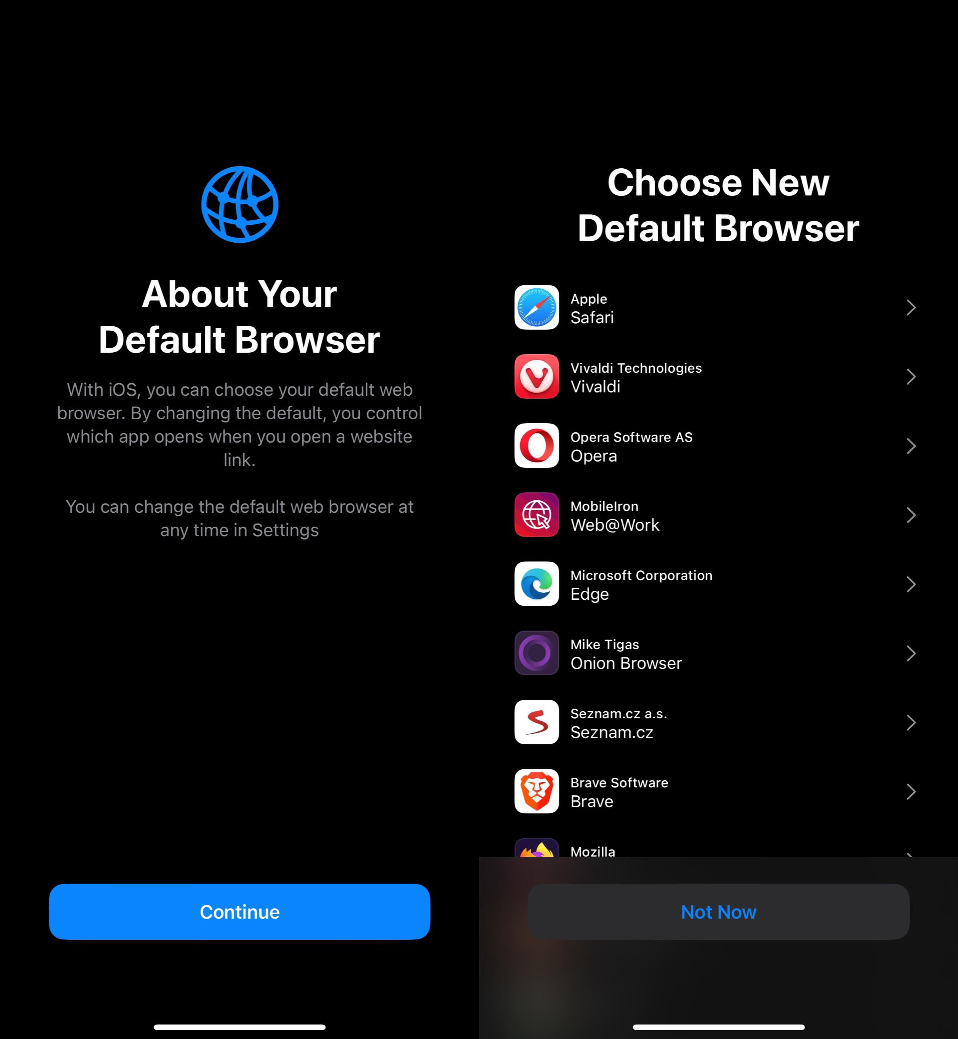
Uninstallation Easily Switchable Defaults, Choice Screens
Apple
2

Slide 15
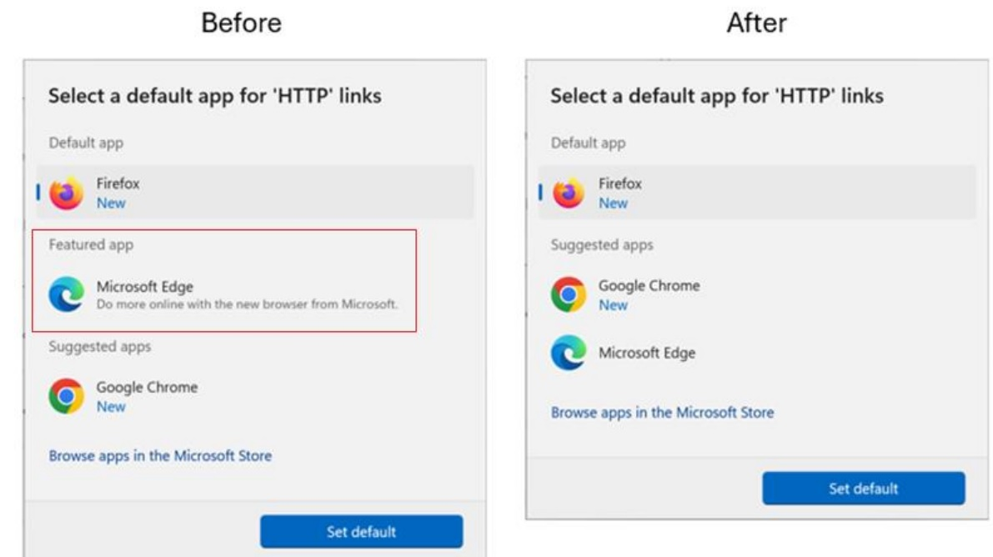
Uninstallation Easily Switchable Defaults, Choice Screens
Microsoft

Slide 16
Uninstallation Easily Switchable Defaults, Choice Screens third-party, cross-service, auto log-in
European Commission has started investigating Apple for noncompliance
“… Apple's measures, including the design of the web browser choice screen, may be preventing users from truly exercising their choice of services within the Apple ecosystem…”
Concerned that the ”Not Now” button allowing users to delay making a choice might defeat the purpose

Slide 17
App Stores – External Offers
Cannot prevent business users from informing their users within the app about cheaper options outside the gatekeeper's ecosystem.
Google
“External Offers program”
Developers can promote and link to external sites
Warn users they’re being taken to an external site without Google Play security
Apple
Developers can inform users of promotions, discounts, and deals available outside of their apps
Inform EU users of the risks associated with using alternatives to the App Store’s secure payment processing

Slide 18
External Purchases – Google Play
Cannot require businesses to use gatekeeper’s own identification, payment, or web browser engine
Before DMA
Developers cannot communicate offers within the app
Developers can communicate offers through other channels, such as email and texts
No purchases made from links promoted in the app
After DMA
Developers sign up for the new fee model External Offers Program
For “purchases that are associated with a Google Play app and that are concluded outside the app.”
Initial acquisition fee: 5% for auto-renewing subscriptions and 10% for in-app digital features, ends after 2 years
Ongoing services fee: 7% for auto-renewing subscriptions and 17% for in-app digital features, can end after 2 years with user consent, will terminate Google Play security services

Slide 19
Alternative Payment Processing Purchases –
Google Play
Cannot require businesses to use gatekeeper’s own identification, payment, or web browser engine
Before DMA
Alternative payment processing only available for non-gaming apps under User Choice Billing
Service fee minus 4% for alternative payment transactions
After DMA
User Billing Choice is expanded to include gaming apps.

Slide 20
Alternative App Marketplaces – Google Play
Allow third- party apps and app stores to be installed on their operating systems.
Before DMA
Google Play already complied because it allows users to sideload third-party apps and app stores onto their device.

Slide 21
External or Alternative Payment Processing Purchases – Apple
Cannot require businesses to use gatekeeper’s own identification, payment, or web browser engine
Before DMA
Developers cannot communicate offers within the app
Developers can communicate offers through other channels, such as email and texts
No purchases made from links promoted in the app
No alternative payment processing
No fee for non-digital transactions
After DMA
Developers sign up for New Business Terms to be able to offer external or alternative payment processing transactions
  Reduced commission on transactions for iOS apps on AppStore
  Core Technology Fee - €0.50 for each first annual install per year over a 1 million threshold
    Includes installs from alternative app stores
      Applies to free apps and apps offering non-digital transactions

Slide 22
Alternative App Marketplaces – Apple
Allow third- party apps and app stores to be installed on their operating systems.
Before DMA
No way to distribute iOS apps from alternative marketplaces
No fee for non-digital transactions
After DMA
Developers sign up for New Business Terms to be able to distribute their iOS apps from alternative app marketplaces
  All iOS apps distributed from the App Store and/or an alternative app marketplace will pay Core Technology Fee - €0.50 for each first annual install per year over a 1 million threshold
      Applies to free apps and apps offering non-digital transactions

Slide 23
Apple App Store - New Business Terms
If developers accept the new business terms, they can go back to the old fee structure only once.
Strong incentive to not accept the new business terms

Slide 24
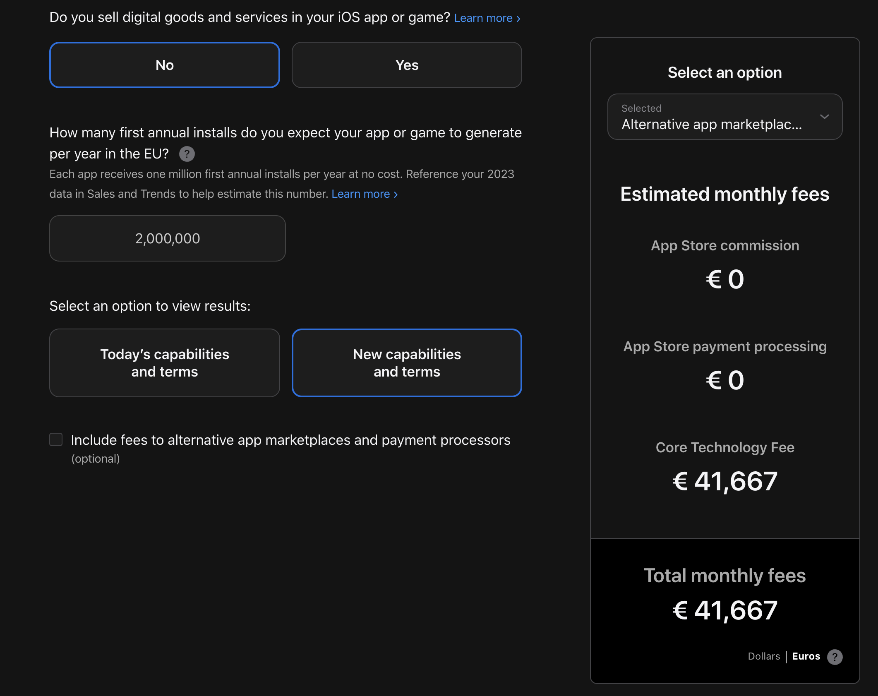
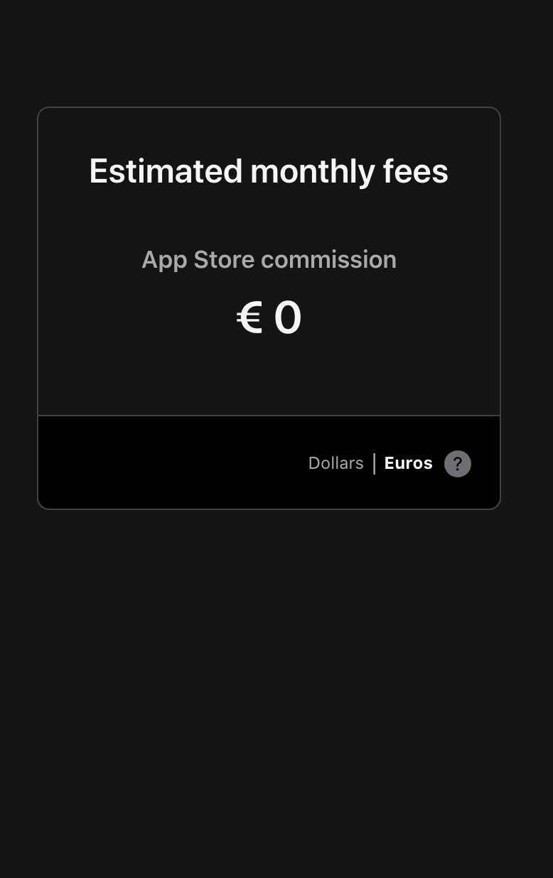
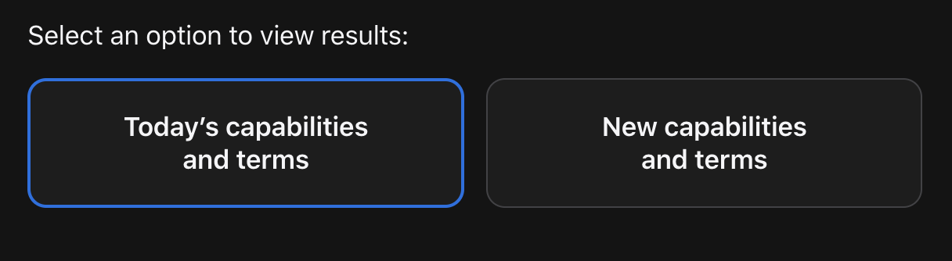
App Store Fees – After DMA
2

Slide 25
Anti-steering
Cannot prevent business users from informing their users within the app about cheaper options outside the gatekeeper's ecosystem.
European Commission has started investigating Google and Apple for noncompliance
“… may not be fully compliant as they impose various restrictions and limitations. These constrain, among other things, developers' ability to freely communicate and promote offers and directly conclude contracts, including by imposing various charges.”

Slide 26
Hurdles to Launching an Alternative App Store
Potential Alternative App Stores
Epic Games Store
MacPaw’s Setapp
AltStore - More likely to launch soon

Slide 27
Hurdles to Launching an Alternative App Store
Too Costly
Core Technology Fee (CTF) €0.50
  App developers pay CTF for each additional install over 1M annual installations
                Third-party app store developers pay CTF for every installation of their app store

Slide 28
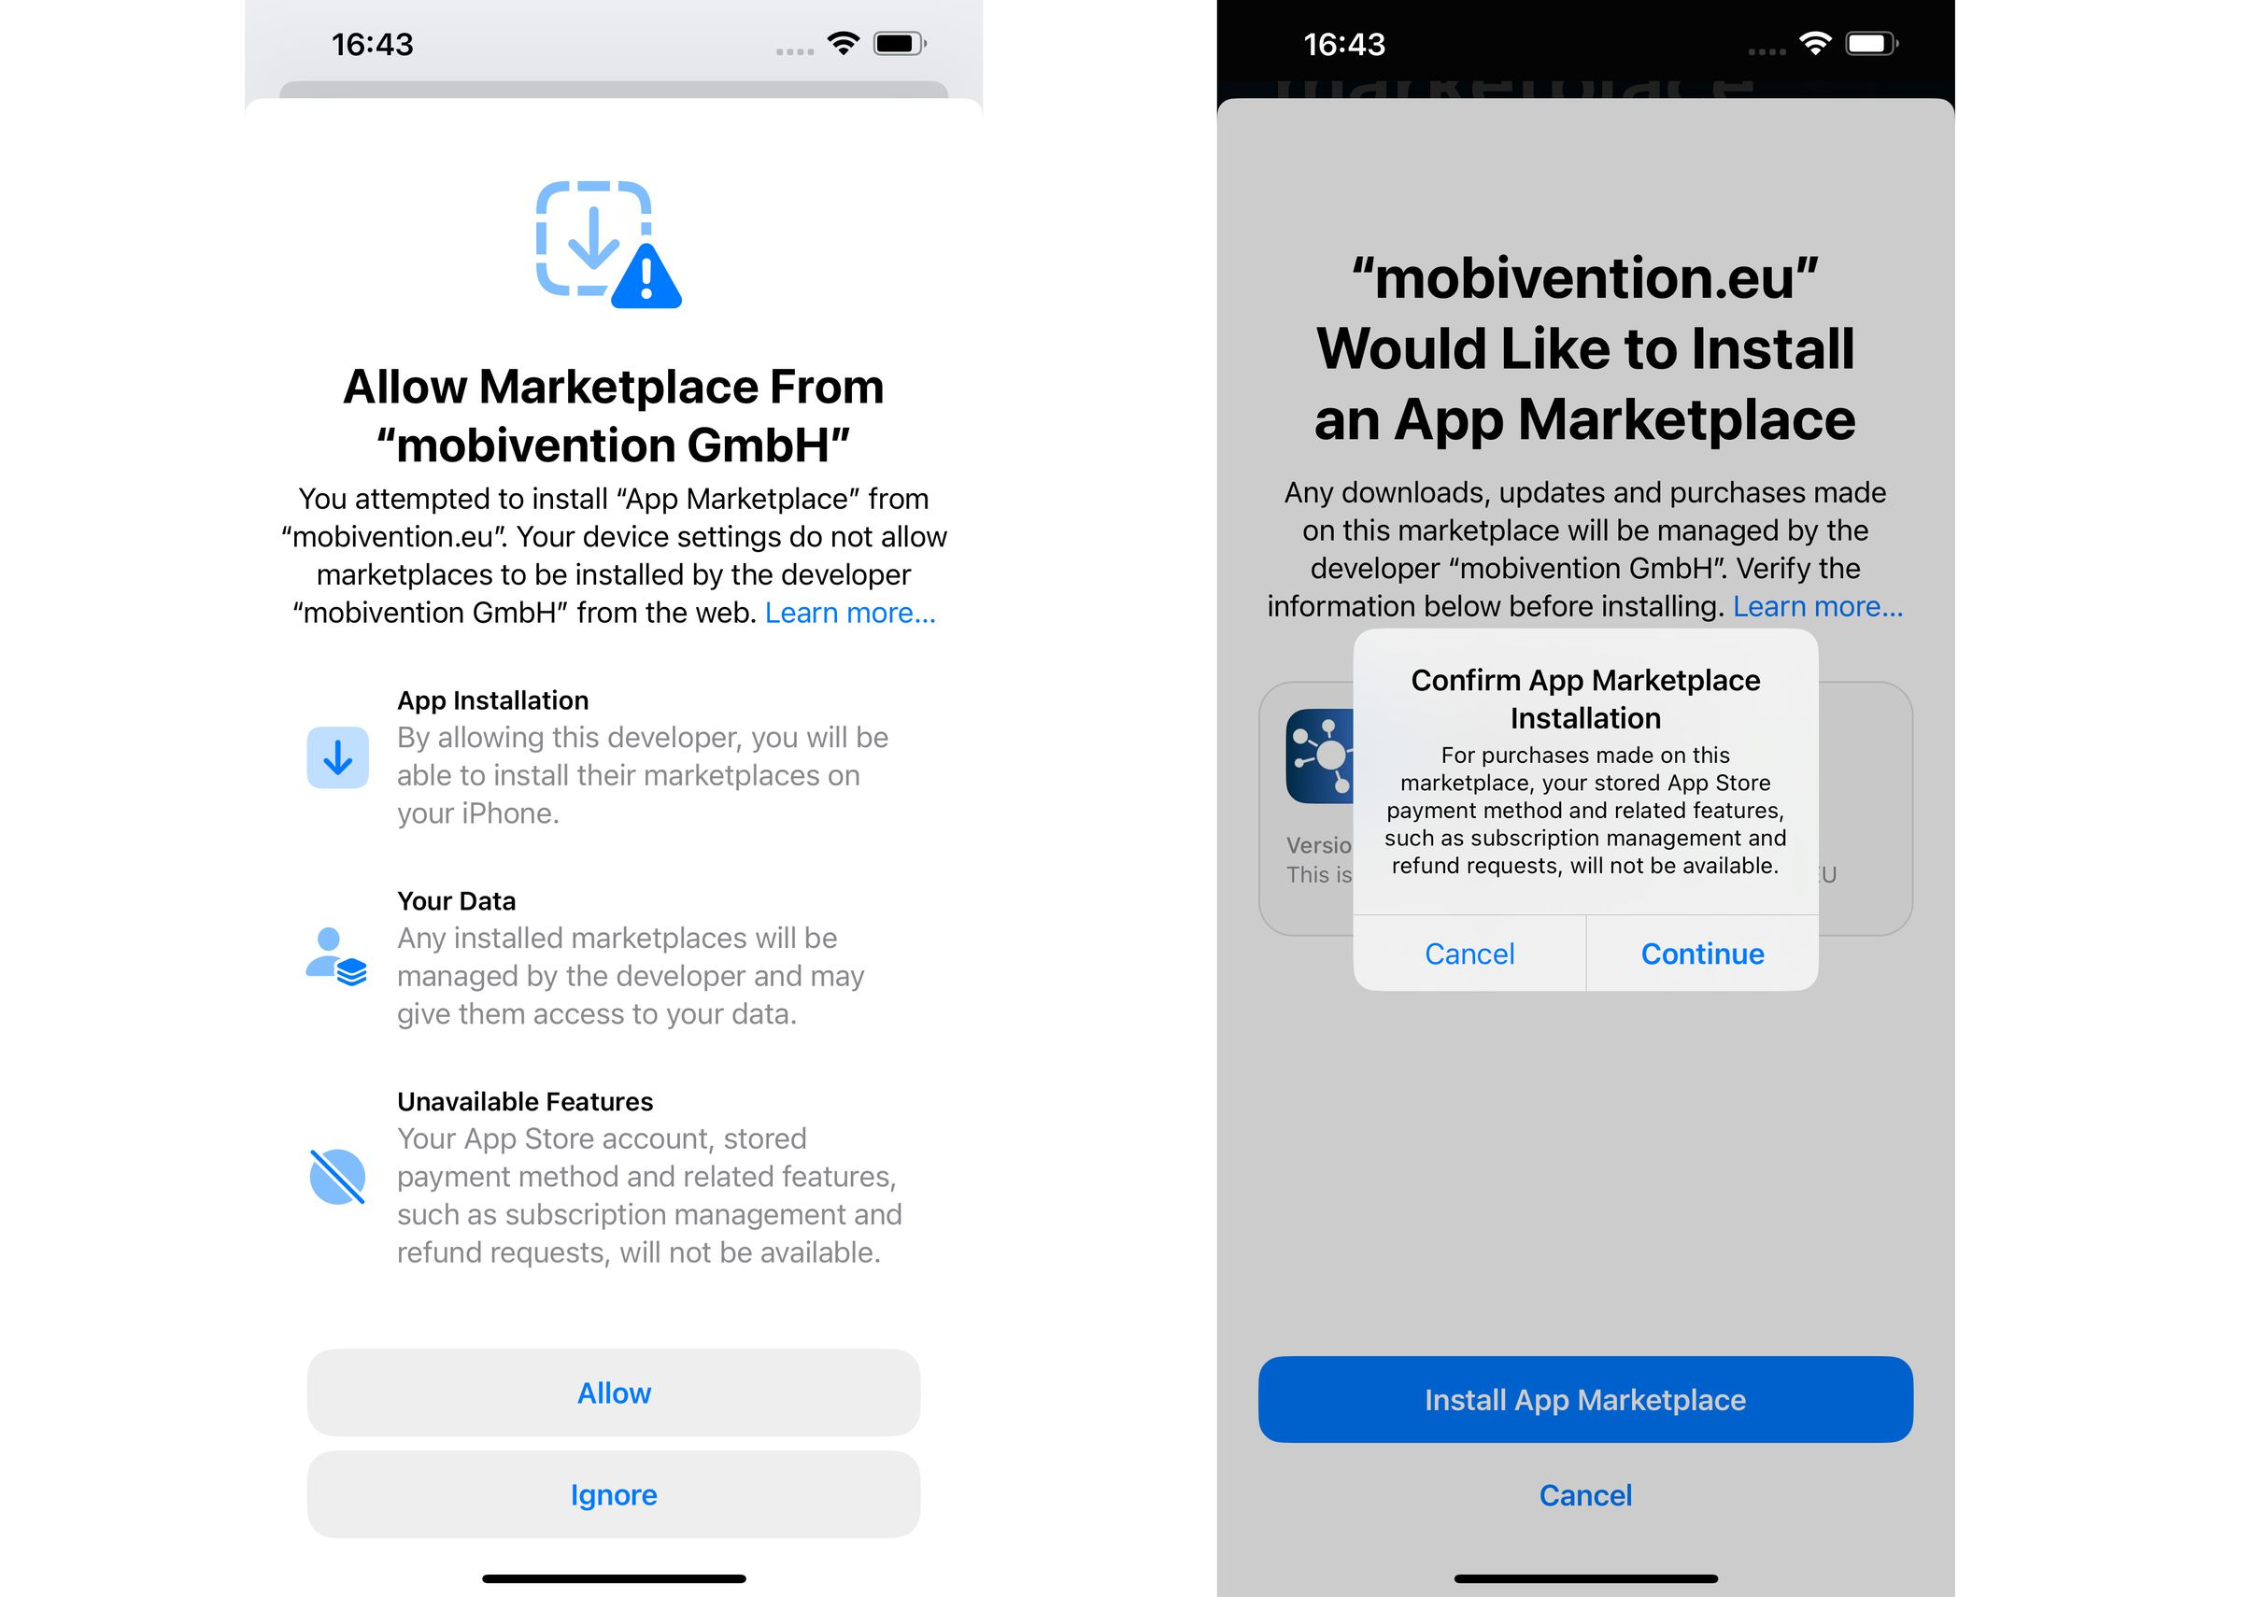
Hurdles to Launching an Alternative App Store
Too Many Roadblocks
Multiple steps when installing the app marketplace – acts as a deterrent
Every marketplace has its own policies when it comes to security, refunds, and policies

Slide 29
“Sideloading” and app stores
Allow third- party apps and app stores to be installed on their operating systems.
European Commission has started investigating Apple for noncompliance
“Apple's new fee structure and other terms and conditions for alternative app stores and distribution of apps from the web (sideloading) may be defeating the purpose of its obligations…”

Slide 30
Data portability
Users can port their data to other platforms free of charge
Apple
Easier ways to transfer data from an iPhone to a non-Apple phone by fall 2025
Retrieve new data about their usage of the App Store and export it to an authorized third-party
Meta
Download Your Information (DYI): receive their information in JSON format
Transfer Your Information (TYI): transfer their Facebook photos and videos directly to, among others, BackBlaze, Dropbox, Koofr, and Google Photos
Regular and automatic recurring transfers for both DYI and TYI
Microsoft
New APIs for third-party developers:
data users have provided on the LinkedIn platform or generated while using LinkedIn
data provided or generated by LinkedIn members through their engagement with Pages, subject to those members’ consent.

Slide 31
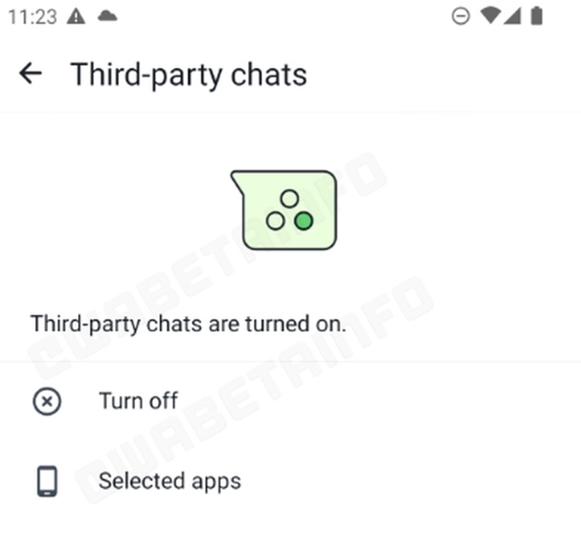
Interoperability for messaging services
Make the basic functionalities interoperable with rival services upon request and free of charge
Apple
Interoperability request form
Developers request compatibility with iPhone and iOS hardware and software features
Meta
Third-party services can use alternative encryption protocols to the tried and tested open-source Signal protocol
Third-party services connect to Meta’s servers directly or use their own proxy server to connect to Meta’s if they prefer
Meta granted an extension of 6 months to comply with the interoperability obligation

Slide 32
Non-discriminatory ranking
Treating their first-party services and products more favorably in ranking compared to similar third-party services.
Google
No reserved links to separate Google services in search results
Allow comparison shopping sites ( CSSs ) to place product ads that lead to CSSs’ sites ( CSS ads ) alongside existing product ads
Ended flights unit on the search results page.
Amazon
Criteria for “Featured Offer” on the product detail page treat third-party sellers and Amazon retail equally

Slide 33
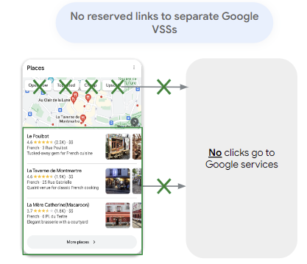
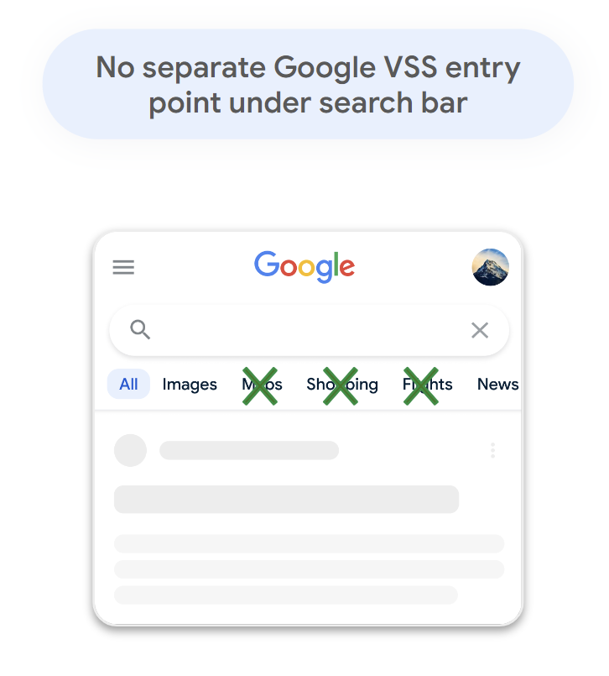
VSS: Vertical Search Services
Google Images, Google Maps, Google News, Google Shopping, etc.

Slide 34
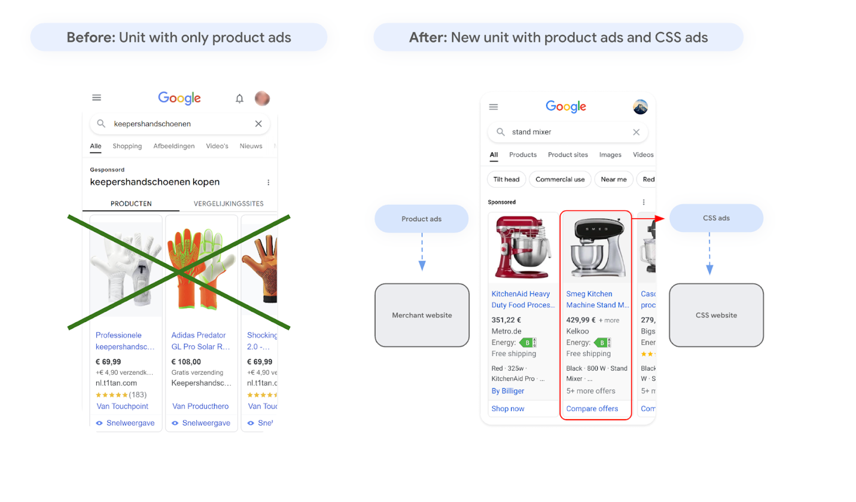

Slide 35
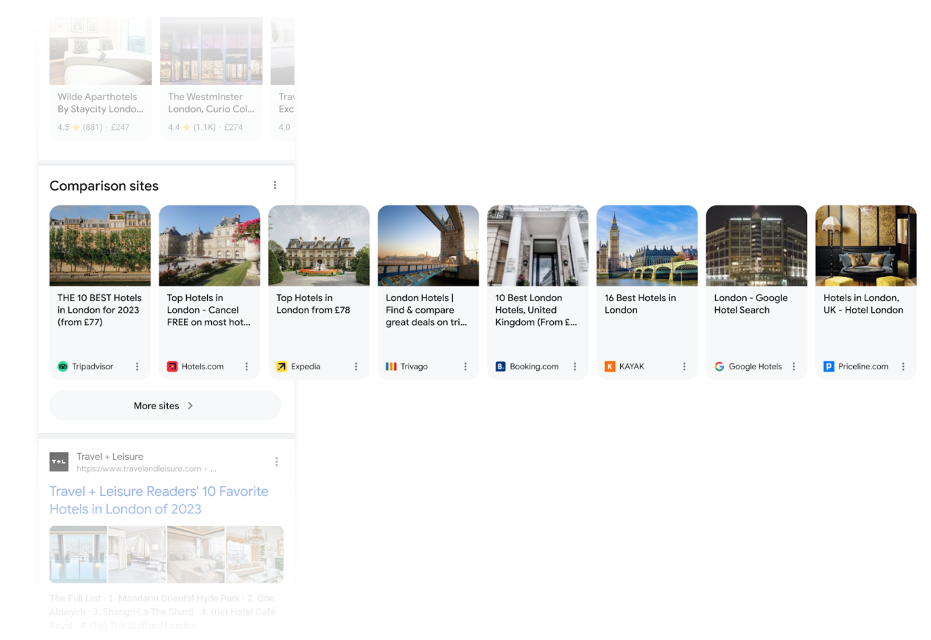

Slide 36
Non-discriminatory ranking
Treating their first-party services and products more favorably in ranking compared to similar third-party services.
Google
Yelp argues that Google does not comply and is still self-preferencing its own services on search engine results pages
“Yelp’s analysis found that Google’s new European search engine results pages (SERPs) actually appear to exacerbate the search giant’s self-preferencing, leading it to keep even more traffic within its own properties than in Google’s pre-DMA search engine results page. We found that Google retained approximately 55% of traffic under its pre-DMA SERPs. Under the new SERPs, Google retains approximately 73% of traffic.”

Slide 37
Non-discriminatory ranking
Treating their first-party services and products more favorably in ranking compared to similar third-party services.
European Commission has started investigating Google and Amazon for noncompliance
“… Alphabet's measures implemented to comply with the DMA may not ensure that third-party services featuring on Google's search results page are treated in a fair and non-discriminatory manner in comparison with Alphabet's own services...”
The Commission argues these changes may not ensure third-party services are treated fairly compared to Alphabet’s own services.
“Amazon may be preferencing its own brand products on the Amazon Store…”

Slide 38
Non-discriminatory ranking
Treating their first-party services and products more favorably in ranking compared to similar third-party services.
European Commission has started investigating Google and Amazon for noncompliance
“Amazon may be preferencing its own brand products on the Amazon Store…”
For example, Amazon did not include Amazon ads as a potential source of conflict of interest.

Slide 39
What Happens Next
EC has up to a year to complete the initial noncompliance investigations
EC can open new investigations in the meantime
Potential fines
Judicial review
European Commission has started investigating Google and Amazon for noncompliance
“Amazon may be preferencing its own brand products on the Amazon Store…”
For example, Amazon did not even include Amazon ads as a potential source of conflict of interest.

Slide 40
How will DMA compliance impact the US and other jurisdictions, noting ongoing antitrust litigation involving the gatekeepers and pending legislation?
European Commission has started investigating Google and Amazon for noncompliance
“Amazon may be preferencing its own brand products on the Amazon Store…”
For example, Amazon did not even include Amazon ads as a potential source of conflict of interest.

